Slide 1
Ustacky Capstone Project for Data Science Micro Degree
Executive Summary

Slide 2
Data Collection
After importing the needed python libraries, the required data was collected from the recommended websites and other sources as follows:
A. From John Hopkins GitHub repository: urlj1 = "https://raw.githubusercontent.com/CSSEGISandData/COVID-19/master/csse_covid_19_data/csse_covid_19_time_series/time_series_covid19_recovered_global.csv"
John_Hopkins_recovered_globa = pd.read_csv(urlj1)
B From NCDC website. However, I have problems scraping data from the website as the COVID19 data on the NCDC website appears not to be functional. I had to copy saved data to my pc and used that for the dataframe, see https://github.com/iroanya/Nigeria-COVID-19-Data-Analysis-Using-Python/blob/main/NCDC%20Covid19%20Data.docx
C. I took data from the Ustacky Github repository to complete the data collection process: urlu = "https://raw.githubusercontent.com/Ustacky-dev/Nigeria-COVID-19-Data-Analysis-Using-Python/main/covid_external.csv"
Nigeria_covid_external = pd.read_csv(urlu)

Slide 3
Data View
I used the standard head() and info() method to view the information in the dataframes.
Eg Nigeria_realGDP.head(2)
Year Q1 Q2 Q3 Q4
0 2014 15438679.50 16084622.31 17479127.58 18150356.45
1 2015 16050601.38 16463341.91 17976234.59 18533752.07

Slide 4
Data Cleaning & Preparation
Having created the dataframes required, I had the problem of scraping Covid-19 data from NCDC website. So what I had to copy data saved on the website and converted this into a dataframe using the format below:
doc = Document("C:\\Users\\ogbo9\\Documents\\Source Code\\NCDC Covid19 Data.docx")
data = []
header = None
for table in doc.tables:
for i, row in enumerate(table.rows):
if i == 0: # First row is the header
header = [cell.text for cell in row.cells]
else:
row_data = [cell.text for cell in row.cells]
data.append(row_data)
Nigera_NCDC_Data = pd.DataFrame(data, columns=header)

Slide 5
The next step in the process was to remove commas and convert numeric data to strings . See format below:
columns = ['No. of Cases (Lab Confirmed)', 'No. of Cases (on admission)', 'No. Discharged', 'No. of Deaths']
for col in columns:
Nigera_NCDC_Data[col] = Nigera_NCDC_Data[col].astype(str)
columns = ['No. of Cases (Lab Confirmed)', 'No. of Cases (on admission)', 'No. Discharged', 'No. of Deaths']
for col in columns:
Nigera_NCDC_Data[col] = Nigera_NCDC_Data[col].str.replace(',', '')
Nigera_NCDC_Data[col] = pd.to_numeric(Nigera_NCDC_Data[col])

Slide 6
Then change column names for easy entry.
Nigera_NCDC_Data.rename(columns={'No. of Cases (Lab Confirmed)': 'Cases',
'No. of Cases (on admission)': 'Hospitalized',
'No. Discharged': 'Discharged',
'No. of Deaths': 'Deaths'}, inplace=True)
Combining data from the different dataframes from the John Hopkins website:
John_Hopkins_merged_global = pd.concat([John_Hopkins_confirmed_global, John_Hopkins_recovered_global, John_Hopkins_deaths_global])
Extracting data for Nigeria:
John_Hopkins_Nigeria_data = John_Hopkins_merged_global[John_Hopkins_merged_global['Country/Region'] == 'Nigeria']
John_Hopkins_Nigeria_data.head() to confirm the extracted data for Nigeria
Changing row names and updating the dataframe.:
new_row_names = ['Infections', 'Discharged', 'Deaths']
John_Hopkins_Nigeria_data.index = new_row_names

Slide 7
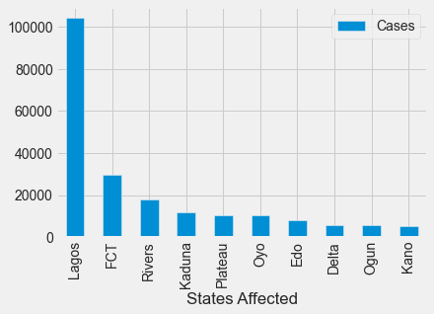
Analysis
# Using DataFrame from NCDC website to plot the top ten rows based on the values in the column 'Cases'
top_ten = Nigera_NCDC_Data.nlargest(10, 'Cases')
# Create a bar plot
top_ten.plot(kind='bar', x='States Affected', y='Cases')
# Show the plot
plt.show()
Lagos topped the list

Slide 8
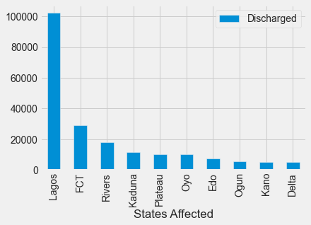
# Using DataFrame from NCDC website I named 'Nigera_NCDC_Data' I want to plot the top ten rows based on the values in the column 'Discharged'
top_ten = Nigera_NCDC_Data.nlargest(10, 'Discharged')
# Create a bar plot
top_ten.plot(kind='bar', x='States Affected', y='Discharged')
# Show the plot
plt.show()
Lagos topped the list

Slide 9
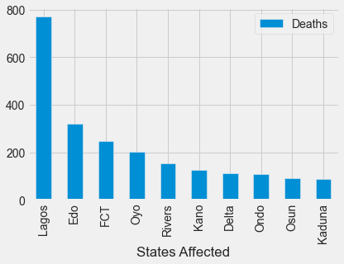
top_ten = Nigera_NCDC_Data.nlargest(10, 'Deaths')
# Create a bar plot
top_ten.plot(kind='bar', x='States Affected', y='Deaths')
# Show the plot
plt.show()
Lagos topped the list

Slide 10
rows_to_plot = ['Infections', 'Discharged', 'Deaths']
# Remove the first four columns because they are not numeric
John_Hopkins_Nigeria_data = John_Hopkins_Nigeria_data.iloc[:, 4:]
# Create a new figure with a specific size (width=15, height=10)
plt.figure(figsize=(15, 10))
# To plot the selected rows
for row in rows_to_plot:
plt.plot(John_Hopkins_Nigeria_data.columns, John_Hopkins_Nigeria_data.loc[row])
# Customize the chart
plt.legend(rows_to_plot)
plt.xlabel('Daily')
plt.ylabel('Rates (Log Scale)')
plt.title('Nigeria Covid19')
# Use a logarithmic scale for the y-axis to eliminate flatlines.
plt.yscale('log')
plt.show()

Slide 11
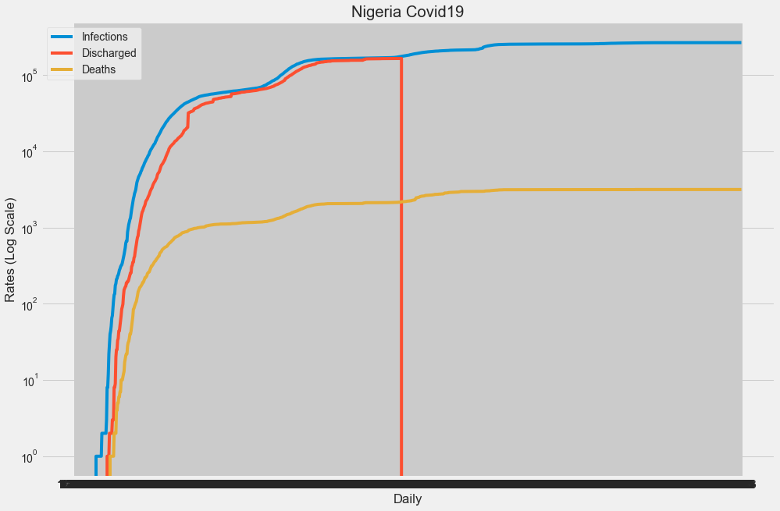

Slide 12
Analysing the same data with subplots.
fig, axs = plt.subplots(3)
fig.suptitle('Nigeria Covid19')
axs[0].plot(John_Hopkins_Nigeria_data.columns, dfjn.loc['Infections'])
axs[0].set(ylabel='Infections')
axs[1].plot(John_Hopkins_Nigeria_data.columns, John_Hopkins_Nigeria_data.loc['Discharged'])
axs[1].set(ylabel='Discharged')
axs[2].plot(John_Hopkins_Nigeria_data.columns, John_Hopkins_Nigeria_data.loc['Deaths'])
axs[2].set(xlabel='Daily', ylabel='Deaths')
plt.show()

Slide 13
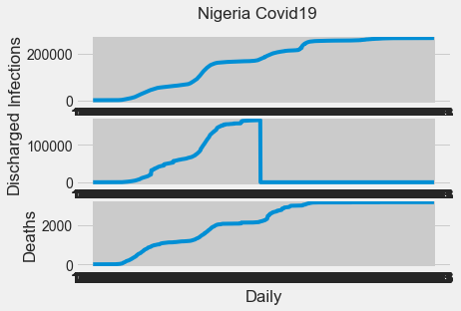

Slide 14
Using the cumulative sum to plot the daily rates.
# Calculate the cumulative sum for each title
John_Hopkins_Nigeria_data_trans_cumulative = John_Hopkins_Nigeria_data.cumsum(axis=1)
# Create the plot
plt.figure(figsize=(30, 10))
for title in John_Hopkins_Nigeria_data_trans_cumulative.index:
plt.plot(John_Hopkins_Nigeria_data_trans_cumulative.columns, John_Hopkins_Nigeria_data_trans_cumulative.loc[title], marker='o', label=title)
plt.title('Cumulative Sum of Daily Rates')
plt.ylabel('Day')
plt.xlabel('Cumulative Sum')
plt.yscale('log')
plt.legend()
plt.grid(True)
plt.show()

Slide 15
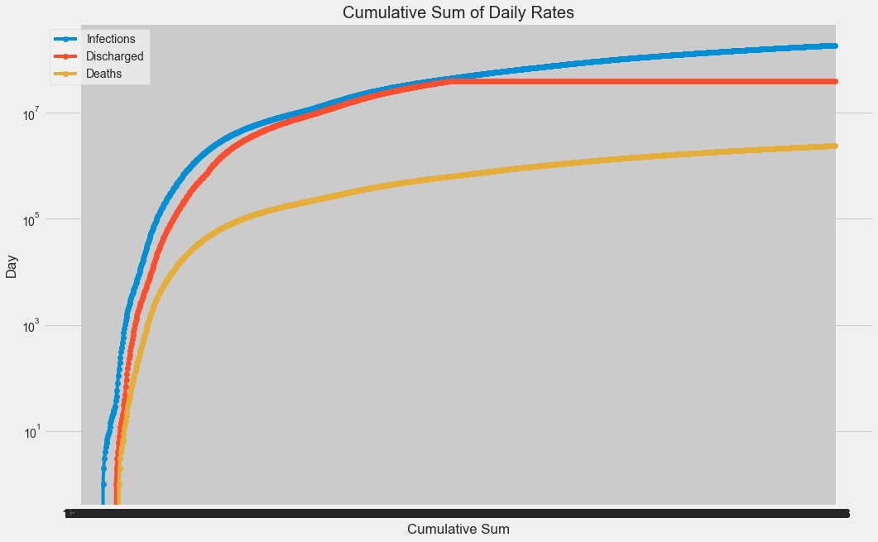

Slide 16
# Using the diff() method to identify and plot the highest infection day, date and number. John_Hopkins_Nigeria_data_transposed = John_Hopkins_Nigeria_data.T
# Calculate the daily difference in 'Infections' and store it in a new column 'daily_infections'
John_Hopkins_Nigeria_data_transposed['daily_infections'] = John_Hopkins_Nigeria_data_transposed['Infections'].diff()
# Find the date with the highest infection rate
date_highest_infection = John_Hopkins_Nigeria_data_transposed['daily_infections'].idxmax()
# Find the highest infection rate
highest_infection_rate = John_Hopkins_Nigeria_data_transposed['daily_infections'].max()
# Plot daily infections
plt.figure(figsize=(20,8))
John_Hopkins_Nigeria_data_transposed['daily_infections'].plot(kind='line', title='Daily Infections Over Time')
plt.xlabel('Date')
plt.ylabel('Daily Infections')
# Highlight the date with the highest infection rate
plt.axvline(x=date_highest_infection, color='r', linestyle='--', label=f'Highest Infection Rate ({highest_infection_rate}) on {date_highest_infection}')
plt.legend()
plt.show()

Slide 17
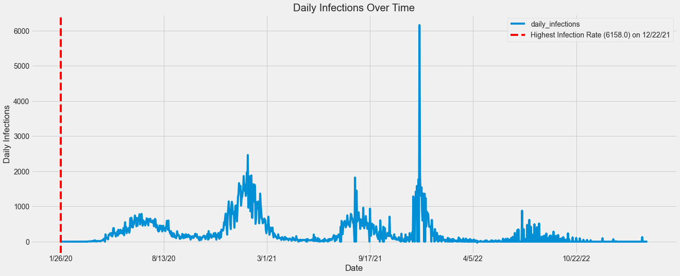

Slide 18
John_Hopkins_Nigeria_data_transposed['daily_deaths'] = John_Hopkins_Nigeria_data_transposed['Deaths'].diff()
# Find the date with the highest infection rate
date_highest_death = John_Hopkins_Nigeria_data_transposed['daily_deaths'].idxmax()
# Find the highest infection rate
highest_death_rate = John_Hopkins_Nigeria_data_transposed['daily_deaths'].max()
# Plot daily infections
plt.figure(figsize=(20,8))
John_Hopkins_Nigeria_data_transposed['daily_deaths'].plot(kind='line', title='Daily Deaths Over Time')
plt.xlabel('Date')
plt.ylabel('Daily Deaths')
# Highlight the date with the highest infection rate
plt.axvline(x=date_highest_death, color='r', linestyle='--', label=f'Highest Death Rate ({highest_death_rate}) on {date_highest_death}')
plt.legend()
plt.show()

Slide 19
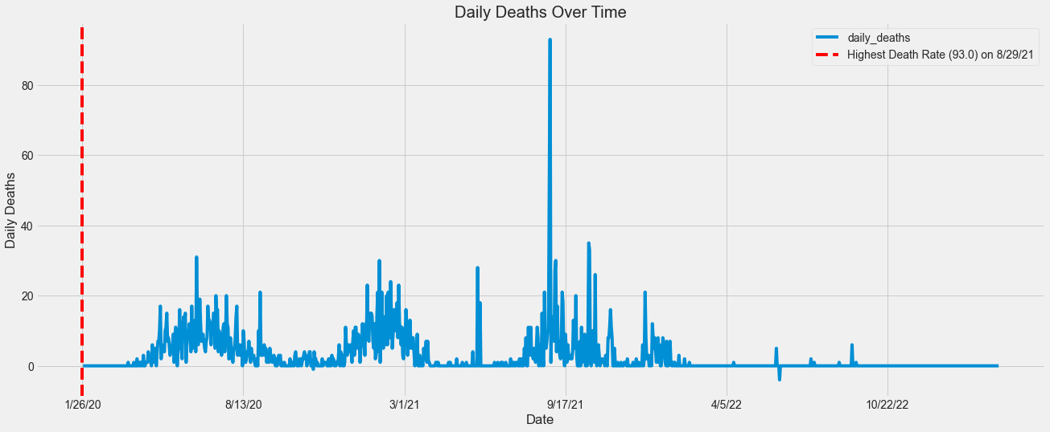

Slide 20
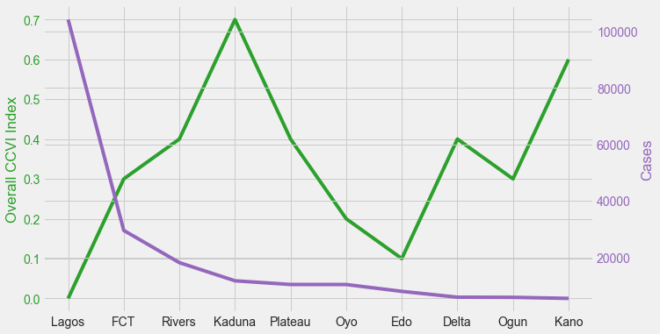
Observations
The vulnerabilty index did not influence the covid-19 cases recorded in the states as shown in the line graph comparing data for both. Lagos with the least CCVI of 0.0 had more cases than all the states in the top ten, including Kaduna with the highest CCVI of 0.7.

Slide 21
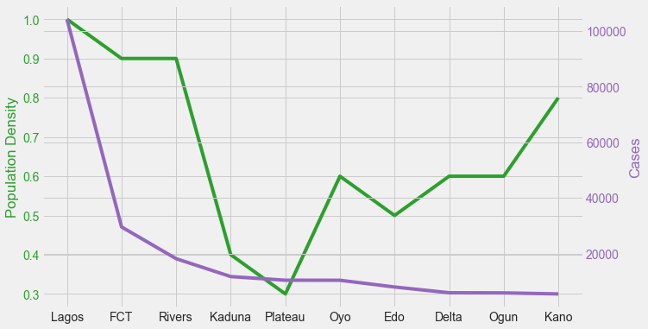
However, when the population Density is compared, the case numbers appear to be more on the states with higher populations except for Kano state.

Slide 22
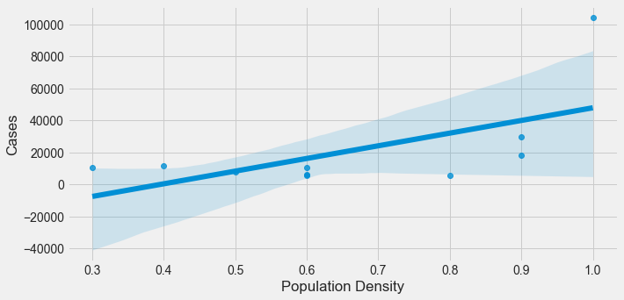
Using a regression plot to generate linear relationship - Cases and Population density, the same conclusion was observed.
fig, ax1 = plt.subplots(figsize=(10, 5))
sns.regplot(x ='Population Density', y ='Cases', data=merged_Nigera_data_top10)
plt.show()

Slide 23
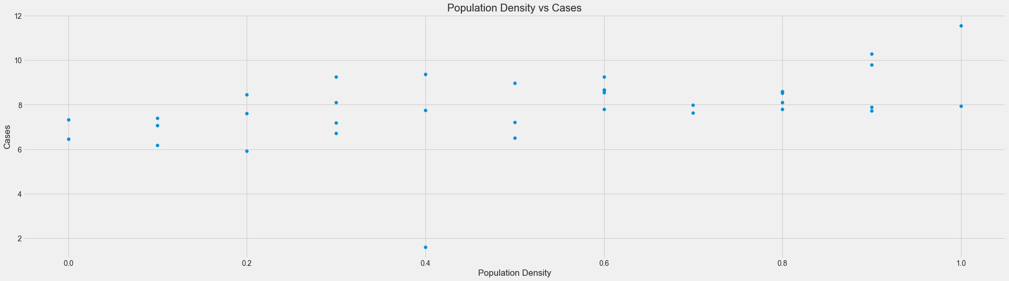
# Plotting columns 'Population_Density' against the log of 'Cases'
plt.figure(figsize=(30,8))
plt.scatter(merged_Nigera_data['Population Density'], np.log(merged_Nigera_data['Cases']))
plt.xlabel('Population Density')
plt.ylabel('Cases')
plt.title('Population Density vs Cases')
plt.show()

Slide 24
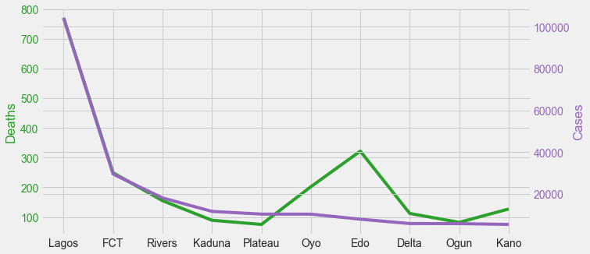
Edo state recorded 7,928 confirmed cases, zero hospitalizations, but with a mortality rate of almost 5% of confirmed cases. This is the highest mortlity rate, making Edo State an outlier.

Slide 25
The external dataset and the NCDC data represent health data from all the states of Nigeria. Combining these two dataframes, the following observations were made.
There were some problems noticed on the NCDC data. Eg, some states recorded zero hospitalizations but with a number of discharged cases. How they were discharged was not captured for clarity purposes.
The vulnerability index did not influence the COVID-19 cases recorded in the states. Lagos with the least CCVI of 0.0 had more cases than all the states in the top ten, including Kaduna with the highest CCVI of 0.7.
However, when the populations are compared, the case numbers appear to be more on the states with with higher populations except for Kano state.
Edo state recorded 7,928 confirmed cases, zero hospitalizations, but with a mortality rate of almost 5%. This is the highest mortality rate, making Edo State an outlier.

Slide 26
Using a regression plot to plot the population density and infections rate, it was observed that Lagos and Rivers were the only states with high population densities and high infections rates. FCT and Kano were outliers with high population densities and infection rates below the regression line (see attached graph in the workbook).
The budget cuts has no direct correlation with the cases numbers. Cross River State had the highest cut with a low infection rate.
Nigeria recorded the highest infection rate of 6,158 on December 22, 2021 and the highest death rate of 93 on August 29, 2021. This shows that a high daily infection rate did not necessarily lead to a higher death rate afterwards.

Slide 27
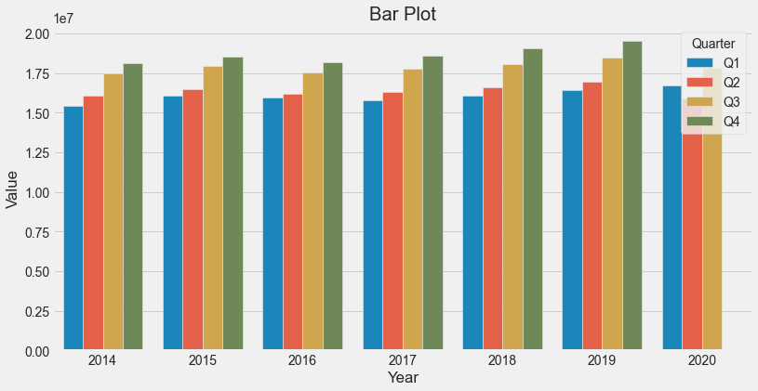
Economic Affects
The following were observed. From 2014, the GDP grew from the first quarter and climaxed by the fourth quarter of every year.

Slide 28
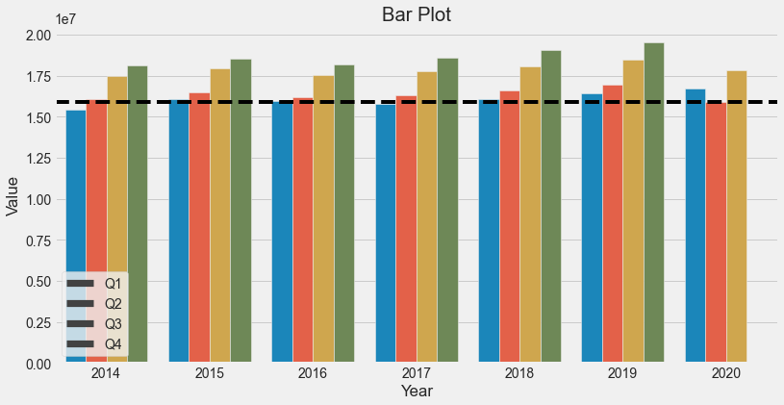
The effect of the pandemic is most noticeable when data from the first quarters are compared. 2020 outperformed the first quarters of the previous years. At the second quarter, which was at the very peak of the pandemic with shutdowns and zero economic activities, the GDP reflected this by going down.

Slide 29
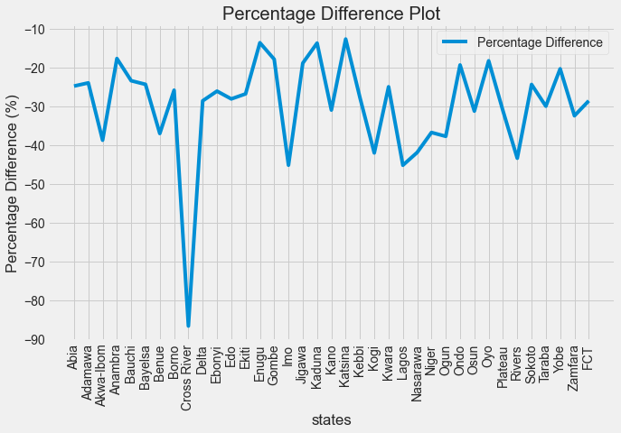
Using the percentage difference in budget data to check the states with the most budget cuts.
plot(Nigeria_budget_data['percentage_difference'] = ((Nigeria_budget_data['Revised_budget (Bn)'] - Nigeria_budget_data['Initial_budget (Bn)']) / Nigeria_budget_data['Initial_budget (Bn)']) * 100)

Slide 30
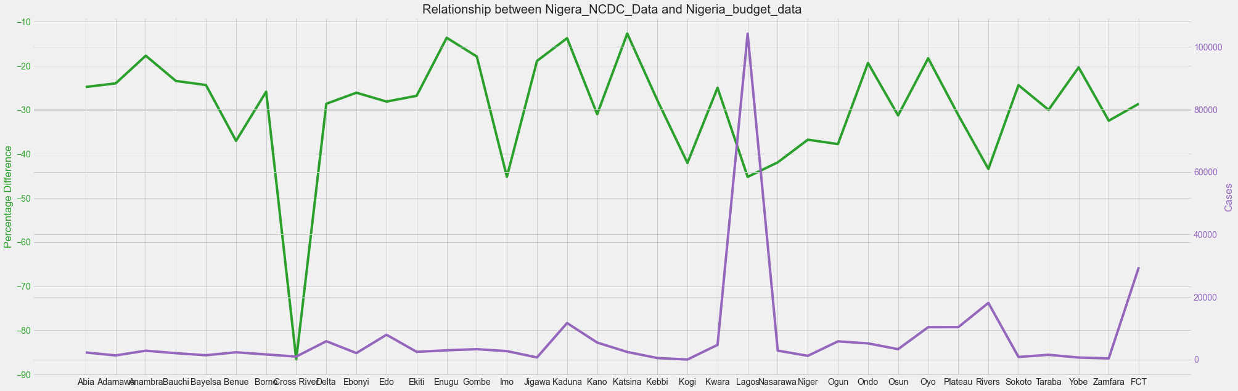
After preparing a line plot comparing the number of cases and the budget percentage difference it was clear that the case numbers had little or no effect on the budget cuts. Lagos had more cases but little cuts and Cross River had a small case volumn but massive budget cut of over 85%.

Slide 31
Plotting bar charts from the extracted GDP data. The following were observed. See attached plots.
From 2014, the GDP grew from the first quarter and climaxed by the fourth quarter of every year.
There was an observable difference on the general improvements year on year, except for 2015 and 2016 which returned almost identical data.
The effect of the pandemic is most noticeable when data from the first quarters are compared. 2020 outperformed the first quarters of the previous years. At the second quarter, which was at the very peak of the pandemic with shutdowns and zero economic activities, the GDP reflected this by going down.
However, by the third quarter, after the lockdowns due to the pandemic and reopening of businesses, the GDP rebounded.

Slide 32
Conclusions
From the studied data it can be deduced that the pandemic had a negative effect on the economy. However, the economy was resilient enough to rebound as soon as the pandemic waned. This recovery speed can only be attributed to an economy that is very robust.
The level of budget cuts was not directly influenced by the infection rates but by the adverse effects of the shutdown.
Again, population densities and CCVI did not affect the overall trend of the pandemic spread. It is worthy of note that the Lagos State health system worked wonderfully well in the treatment and discharge of confirmed cases, thereby averting a high death toll.
The daily recorded infection rate did not translate to a higher mortality rate. Death rates were higher at the beginning of the pandemic and waned later on. This can be ascribed to the fact that as the medical response became more effective the survival rate improved.

